Slide 1
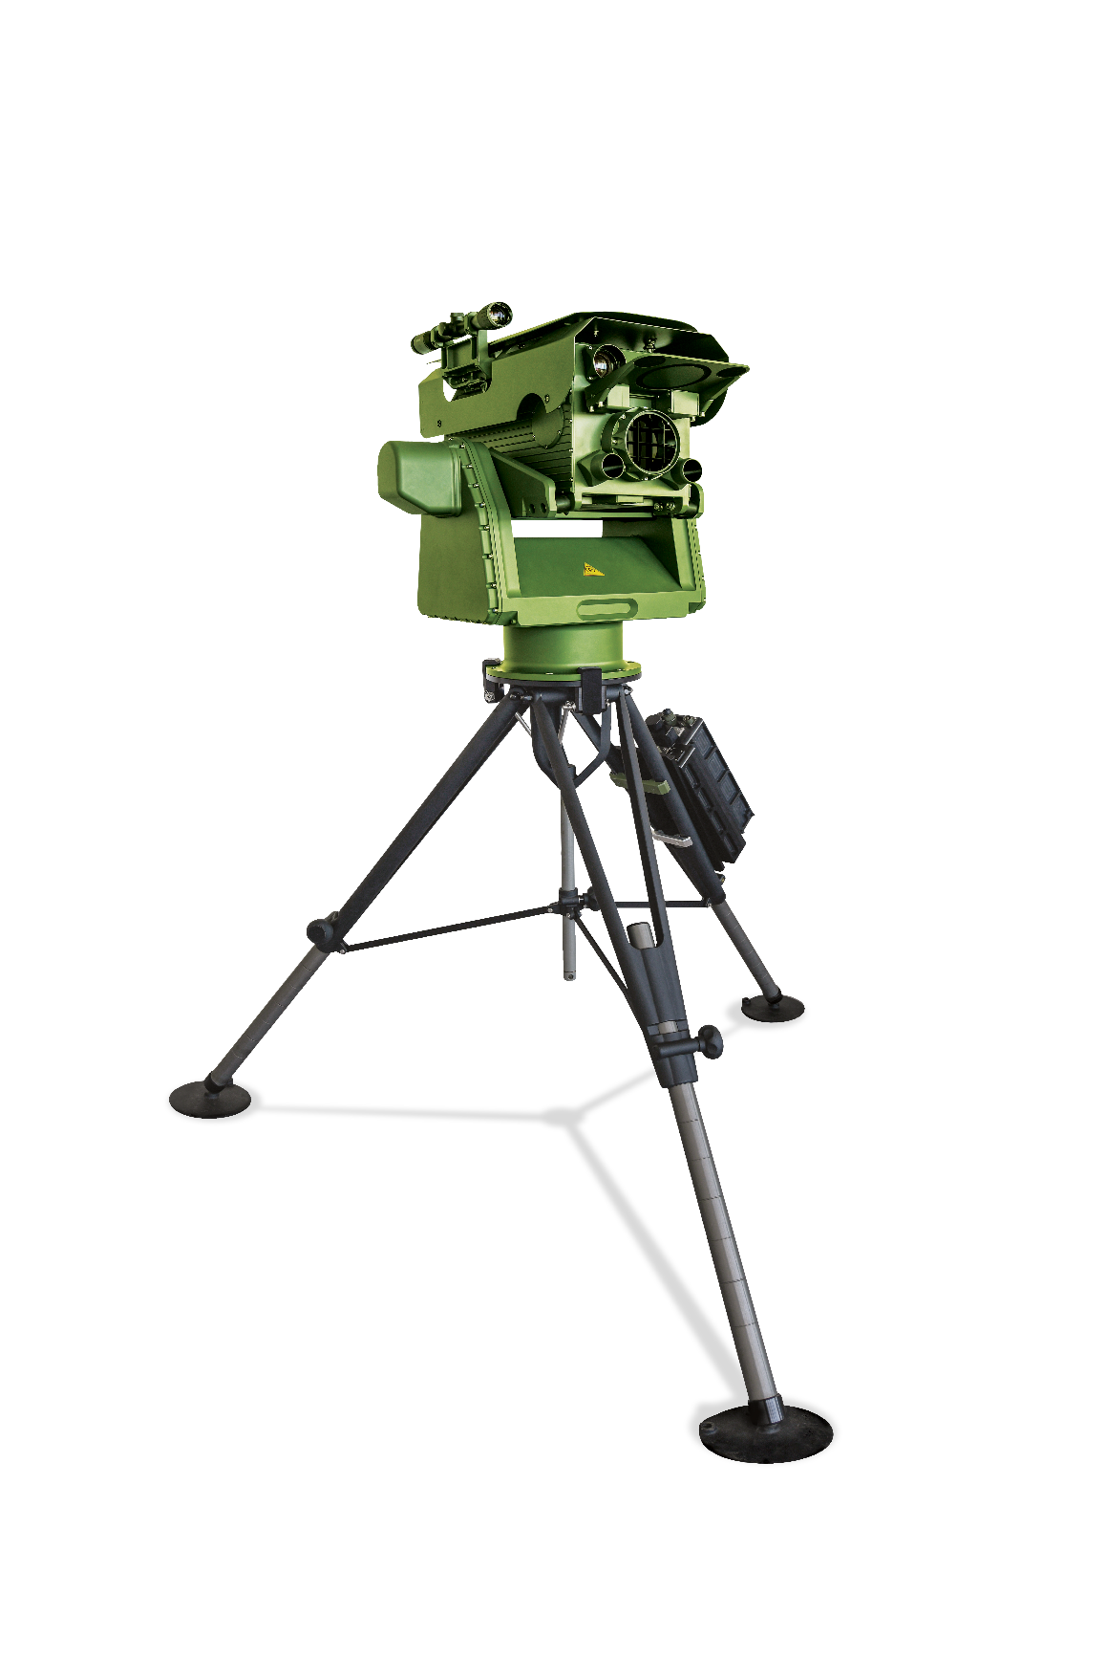
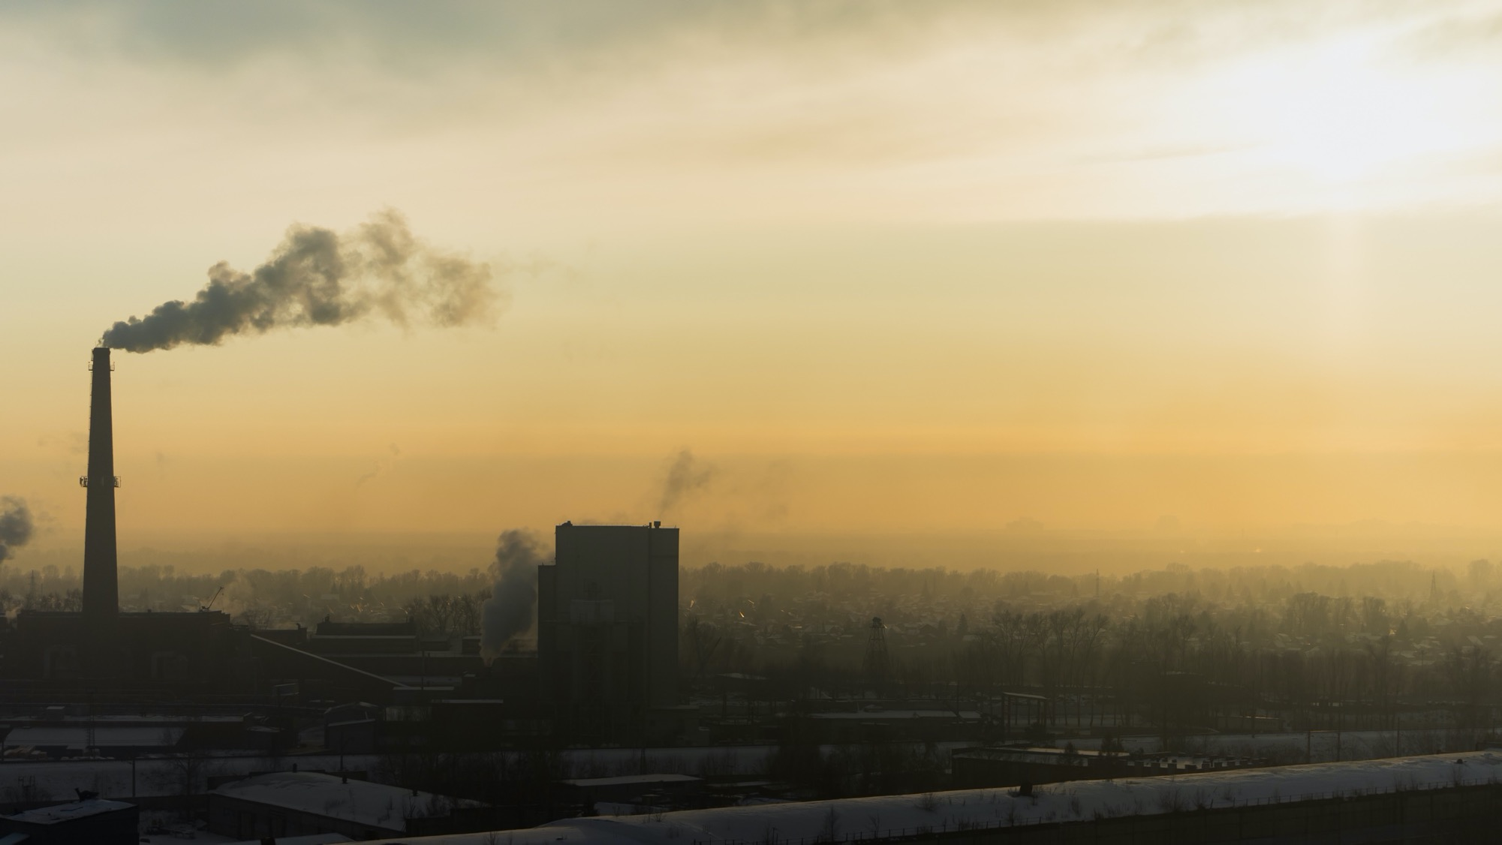

LONG-RANGE
ACTIVE STAND-OFF
CHEMICAL DETECTOR

Slide 2



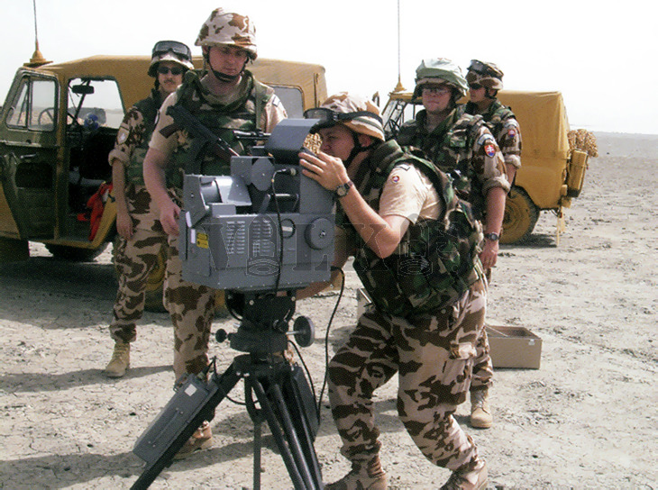
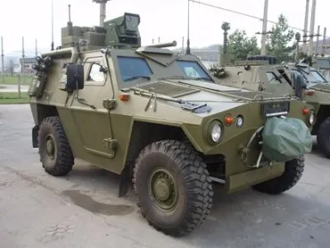
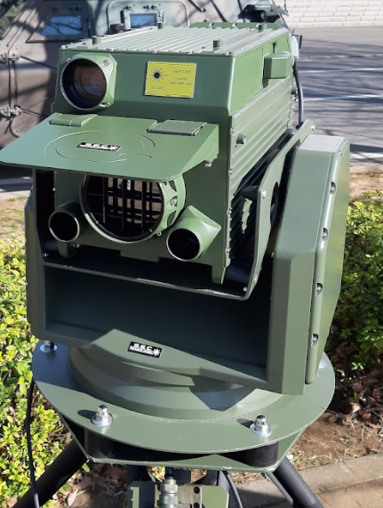
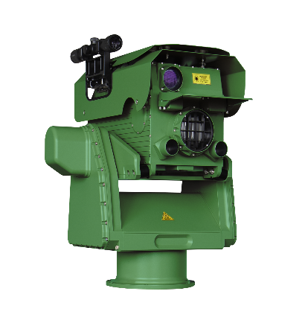
HISTORY OF ACTIVE (LASER) STAND-OFF TECHNOLOGY
1994
2003
2005
2011
2016
2023
4Q 2025
Kuwait
“Enduring Freedom”
Deployment
1st Gen DD-CWA
2nd Gen
DD-CWA
3rd Gen
DD-CWA
4th Gen
Falcon 4G
4th Gen
Falcon 4G update
Falcon 4G BLOCK 2

Slide 3




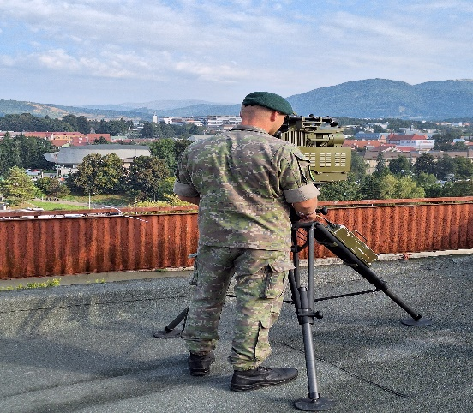
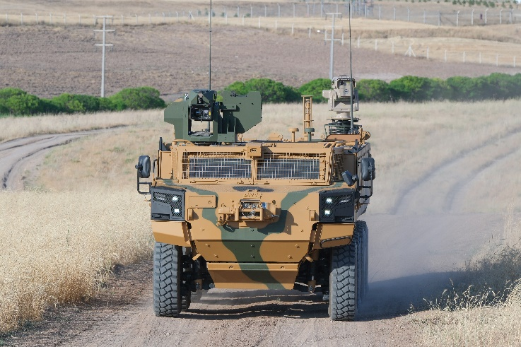
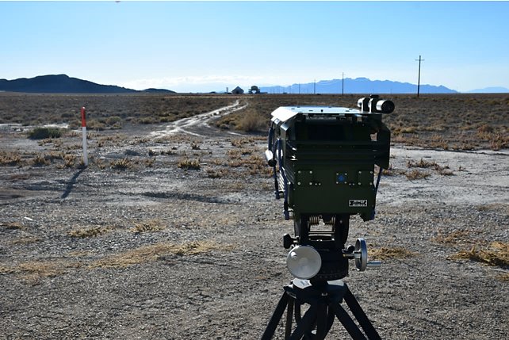
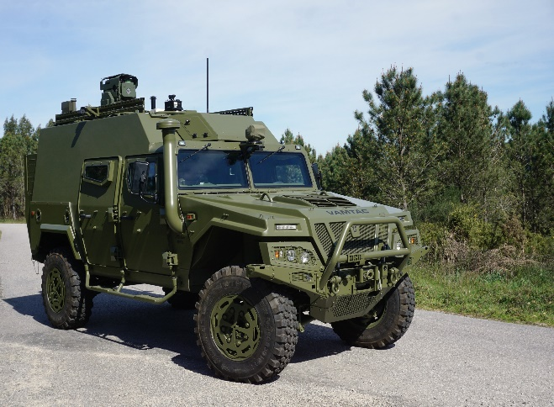



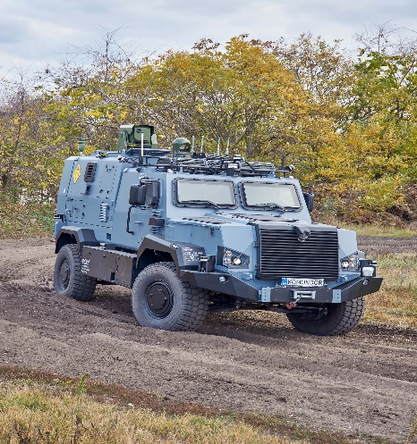
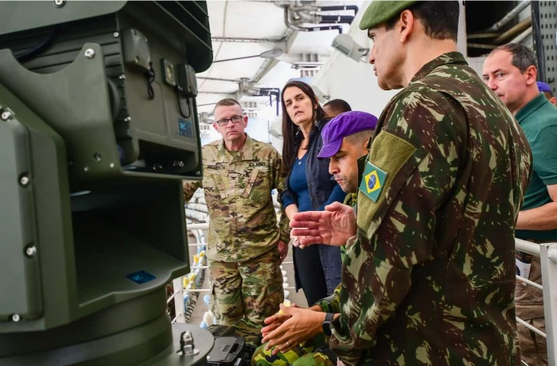
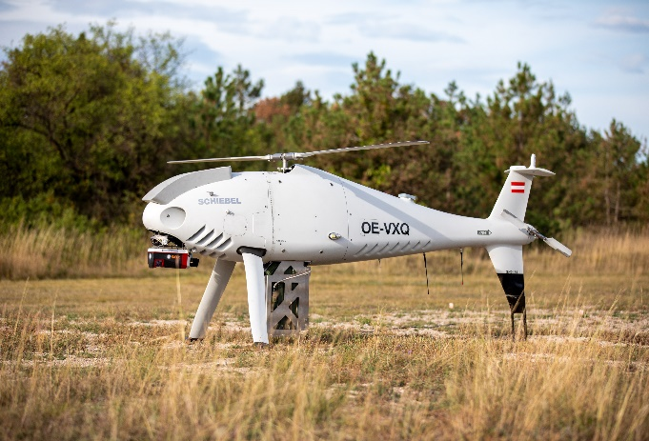
FALCON 4G REFERENCES
ACTIVE USERS
THE SLOVAK ARMED FORCES
THE SPANISH ARMED FORCES
THE TURKISH ARMED FORCES
TECFT DUGWAY, USA
The Brazilian Army
S. Korea, Poland, Hungary, KSA
Luxemburg, Austria

Slide 4
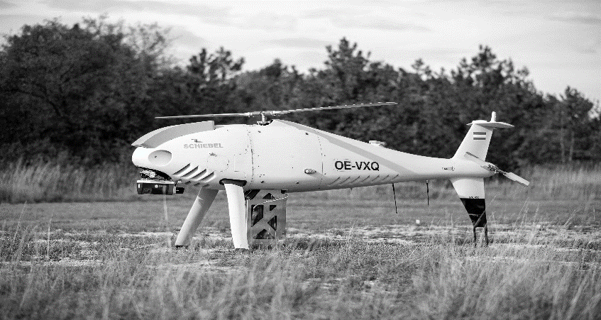
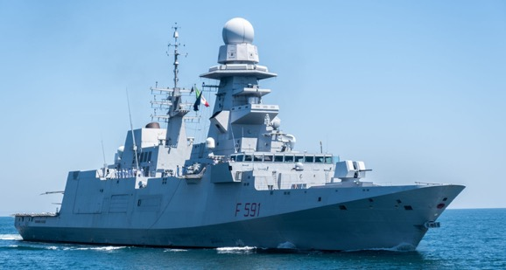
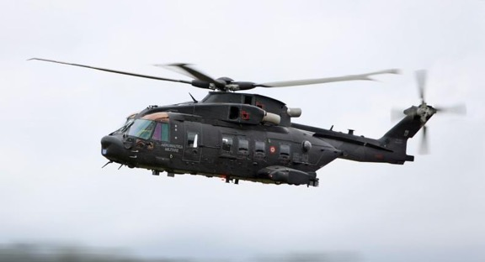
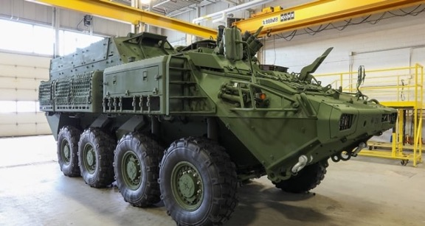
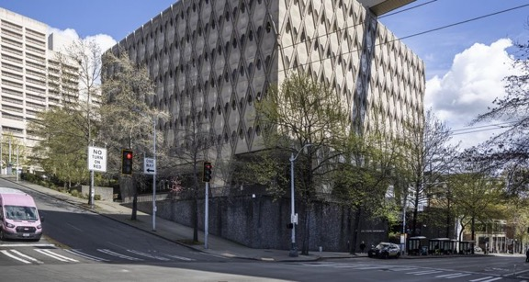
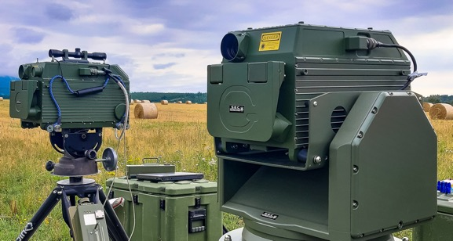
FALCON 4G MOUNTING OPTIONS
UAS (UAV/UGV)
VESSEL
HELICOPTER
VEHICLE
BUILDING
PORTABLE

Slide 5
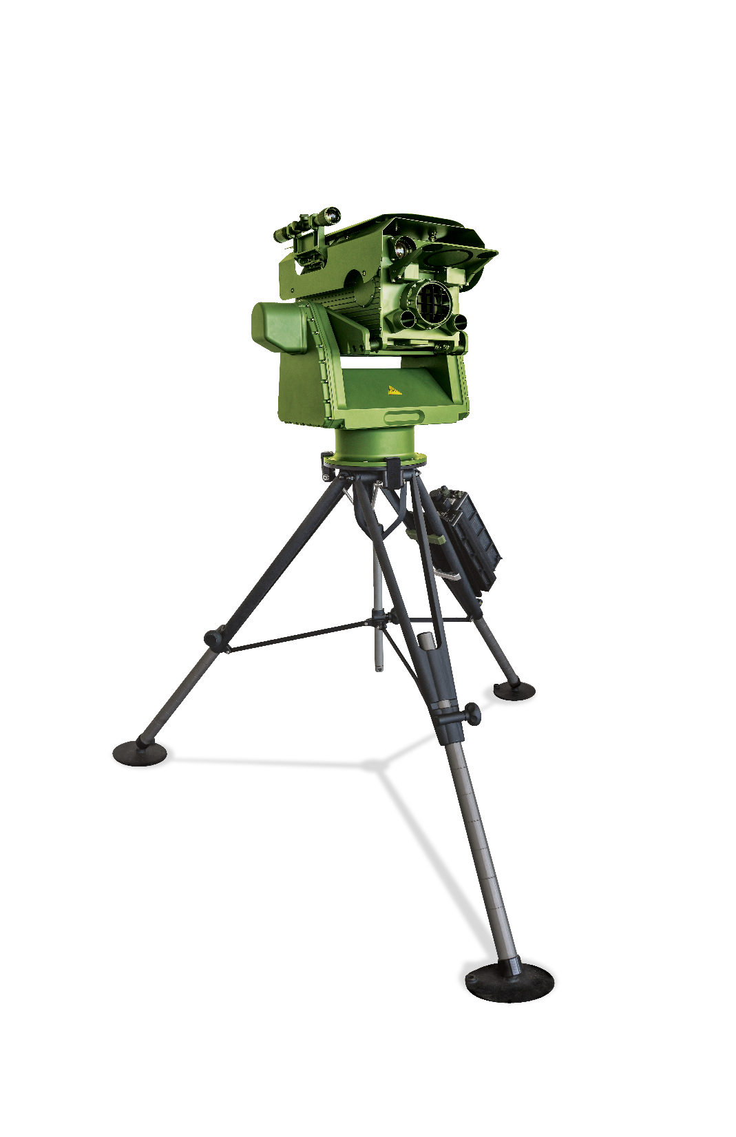
ABOUT FALCON 4G
TELESCOPIC SIGHT
DETECTOR
DETECTION RANGE UP TO 6 KM
P/T POSITIONER
NO CALIBRATION NEEDED
HOT SWAP BATTERY and FALCON INTERFACE UNIT (FIU)
BATTERY (NATO STANDARD BB 2590/U) OPERATED 25W
TRIPOD
NEW MULTILINE ALGORITHM
FOR FASTER DETECTION - THE
WHOLE LIBRARY IN 8 SECONDS

Slide 6







ADVANTAGES OF FALCON 4G
INDEPENDENT OF THE BACKGROUND TEMPERATURE
UNDETECTABLE LASER TECHNOLOGY
DETECTION IN VARIOUS WEATHER CONDITIONS
EYE SAFE CLASS 1
30 x BETTER SENSITIVITY DUE TO THE LASER TECHNOLOGY
DETECTION ON THE MOVE
LONG DETECTION RANGE
MIL STANDARD

Slide 7
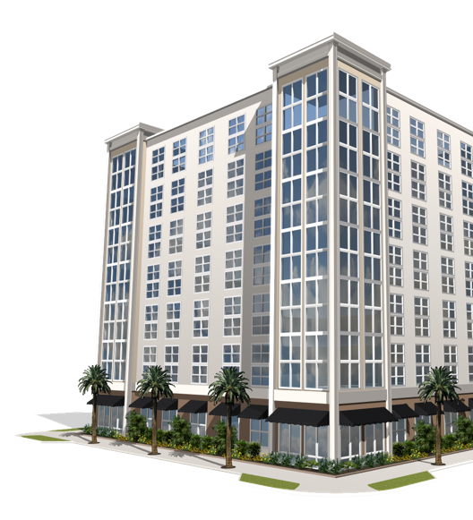

PASSIVE AND ACTIVE APPROACH OF THE DETECTION
PASSIVE STAND-OFF DETECTION
T_{background}
ΔT = T_{background –} T_{cloud} ≠ 0
Relies on infrared radiation from the environment (buildings, trees etc.
Does not emit the optical radiation towards the background
Needs temperature difference between cloud and background
CHEMICAL CLOUD

Slide 8
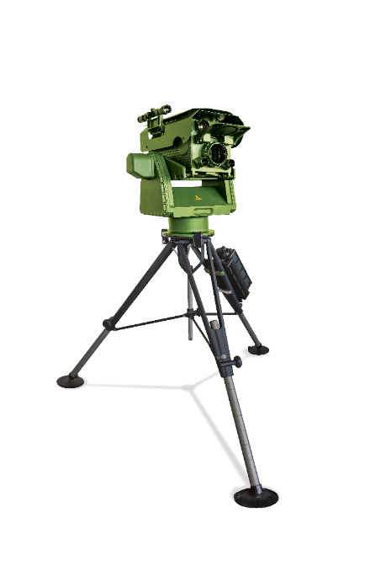
PASSIVE AND ACTIVE APPROACH OF THE DETECTION
ACTIVE STAND-OFF DETECTION
The utilisation of two independent pulsed tunable CO₂ lasers.
Long-range detection up to 6 km
No Delta T required, detects secondary clouds
CHEMICAL CLOUD
Notes:
A secondary cloud is a second airborne plume that forms after the initial release of a hazardous substance. It can appear minutes to hours after the primary cloud and is usually caused by re-evaporation, resuspension, or delayed release of the material.

Slide 9
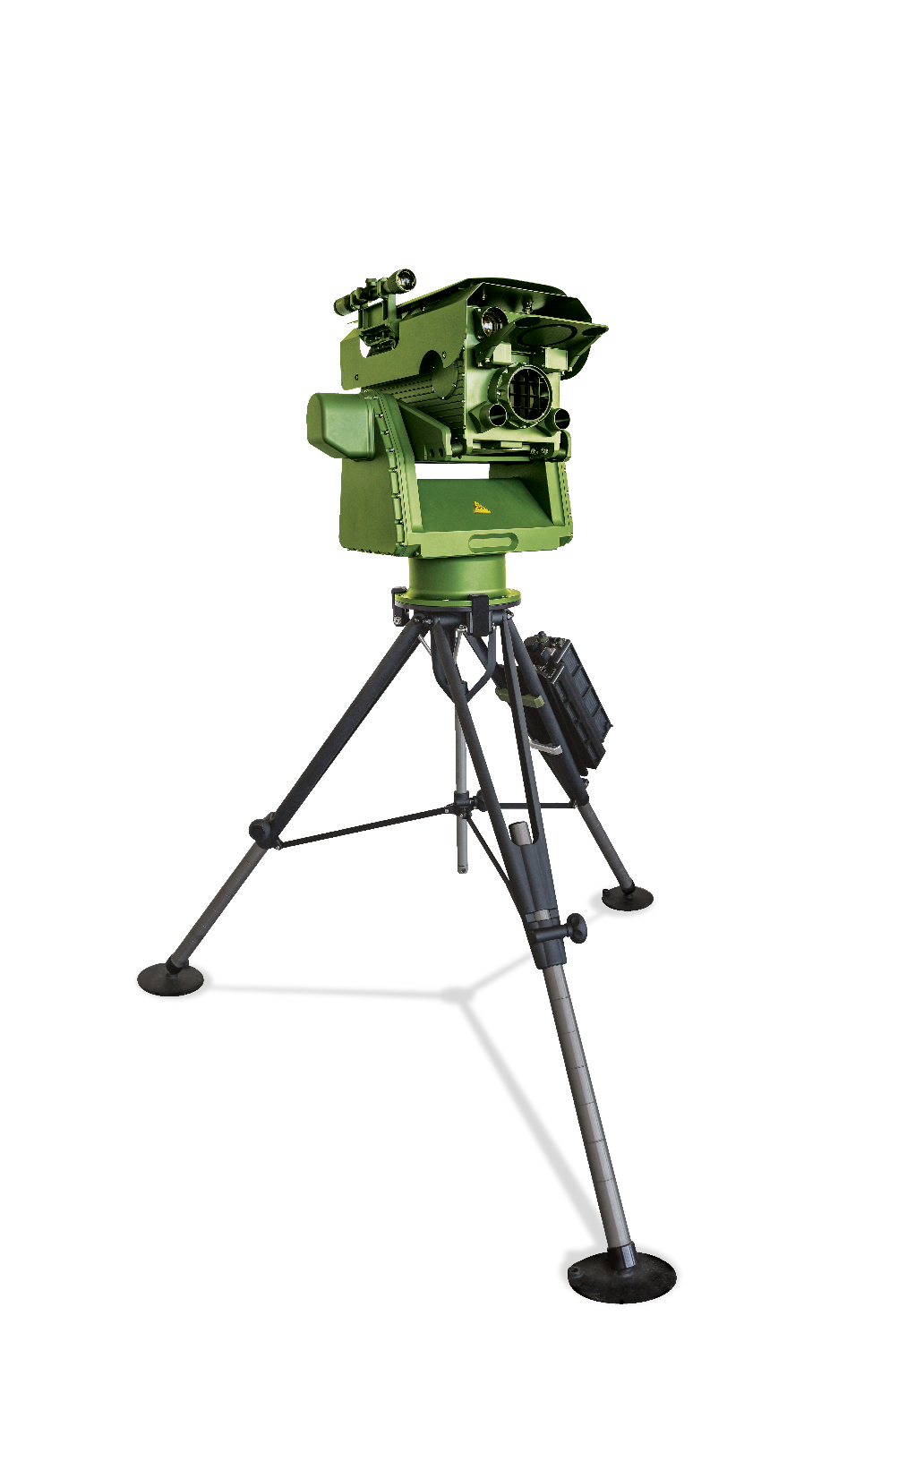
PRINCIPLE OF DIAL DETECTION
Signal received by the detector
Signal sent by two lasers
CHEMICAL CLOUD
Reflected Target
Notes:
LIDAR (DIAL) Two laser pulses are emitted:
On-line wavelength: absorbed by the target gas
Off-line wavelength: not absorbed, used as a reference
Light travels through the air and some is backscattered by air molecules or particles.
Detector measures the backscattered light at both wavelengths.
Gas concentration is calculated based on the difference in absorption between the on-line and off-line signals.

Slide 10
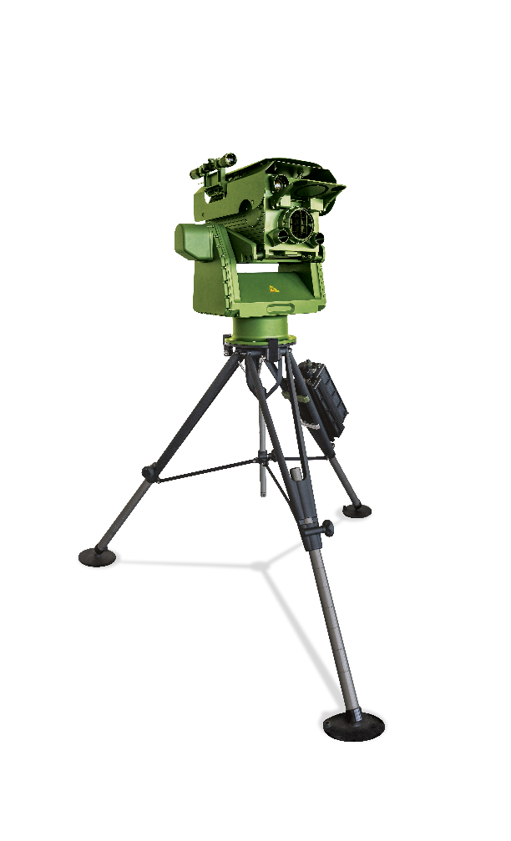
FIELD OF VIEW (FOV)
SHARPER SENSES OF FALCON 4G
30mRAD
ACTIVE STAND-OFF DETECTION
150M
1
Narrow field of view – FoV
1 mRad
Low clouds detection (due to the molecular weight of substances)
Detection through narrow spaces
Detection of the secondary cloud
90M
2
16mRAD
80M
30M
48M
3
16M
3M
5M
1mRAD
1M
CHEMICAL CLOUD
ACTIVE
4
1KM
3KM
6KM

Slide 11
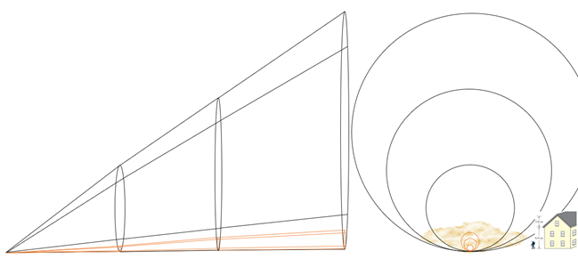
NARROW FIELD OF VIEW
LOW CLOUD DETECTION WITH FALCON 4G

Slide 12
DETECTION DURING TRIALS IN THE IDEAL CONDITIONS
NATO STANDARD CLOUD 300MX300M
CWA DETECTION with passive approach
CWA DETECTION with active system

Slide 13





HOW IT LOOKS IN REALITY
SMALL CLOUD, OBSTACLES IN THE WAY
NO DETECTION- CLEAN AIR
CWA DETECTION with active system

Slide 14


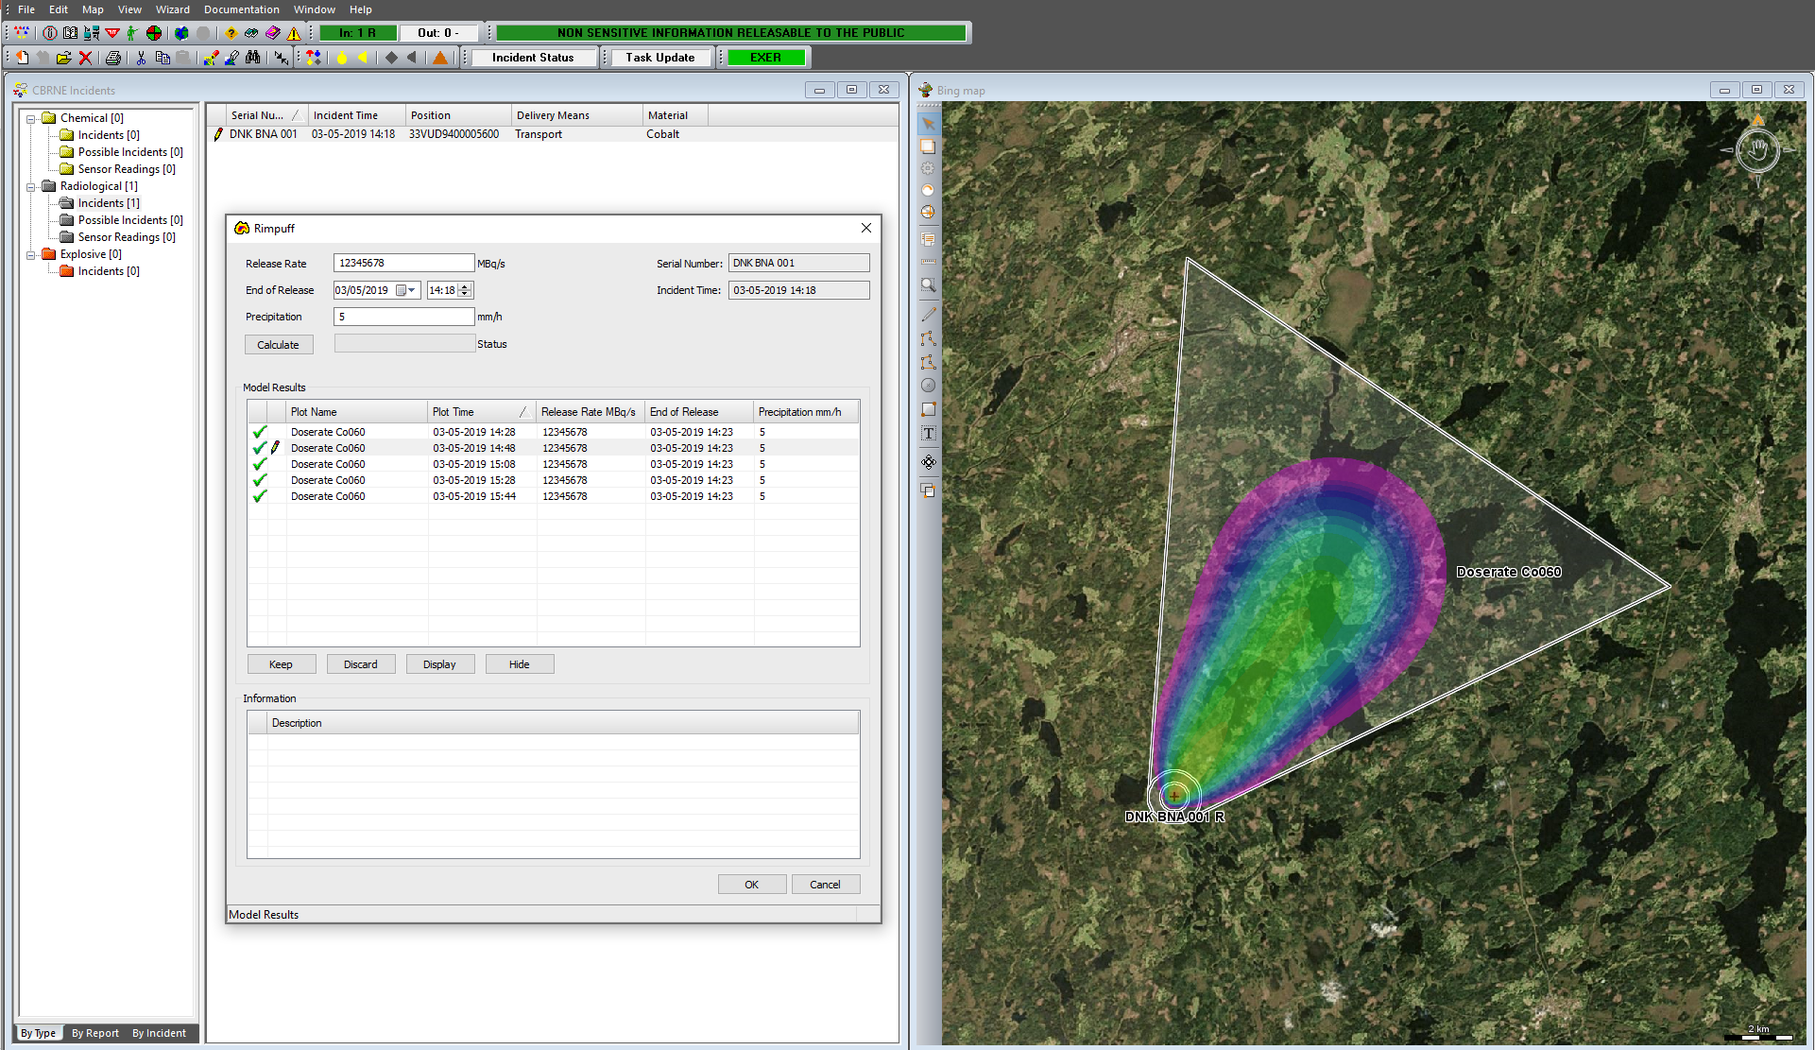
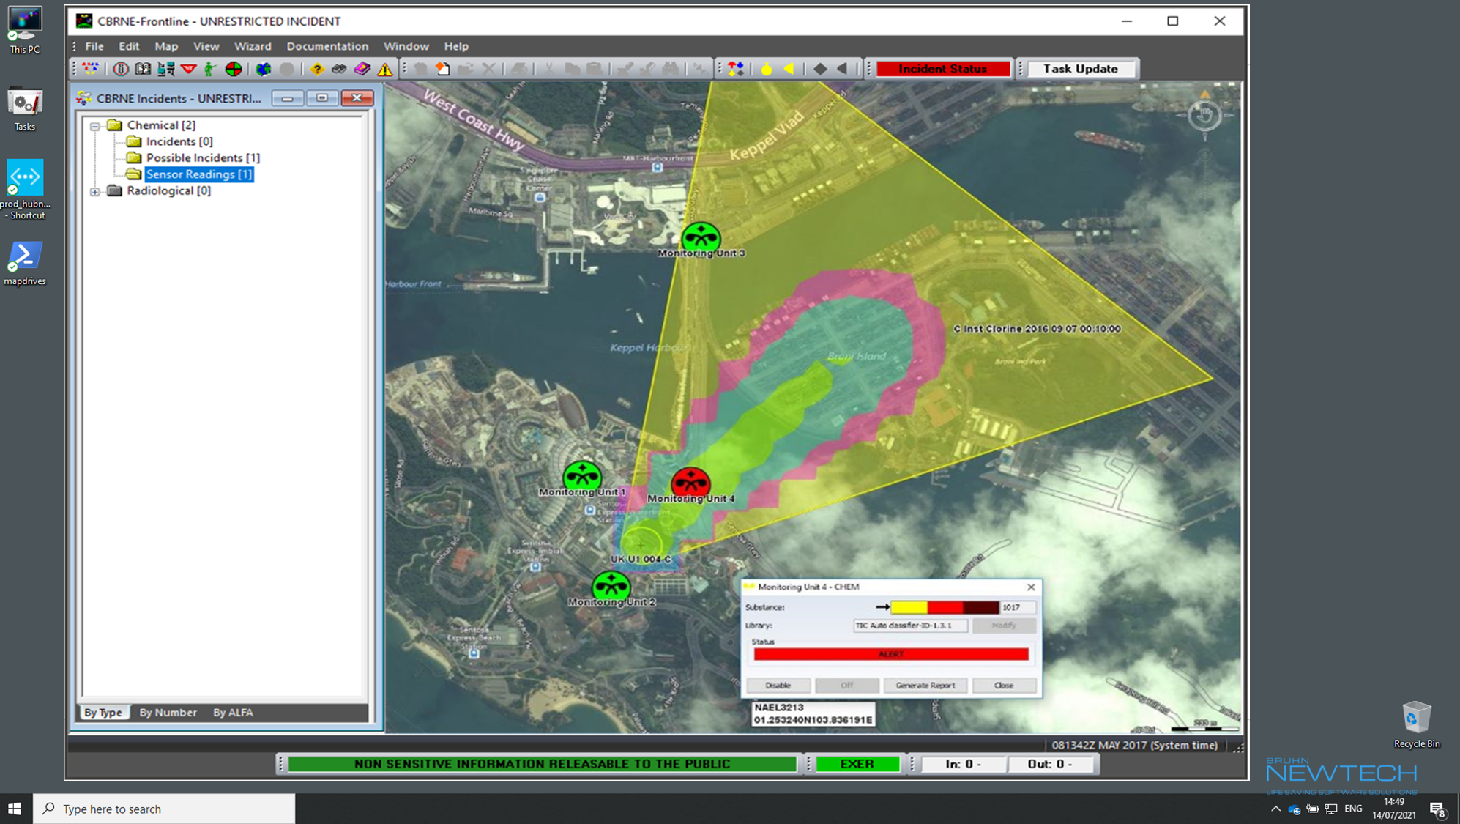
FALCON 4G INTEGRATED WITH ANY C2 SOFTWARE
Falcon 4G can be easily integrated into any C2 software using API.
Falcon 4G is integrated into the
NATO CBRN Functional Service (CBRN-Analysis) through the SCIM® sensor integration module.

Slide 15
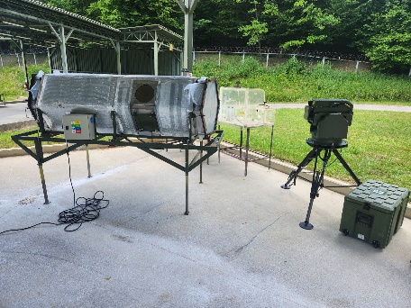
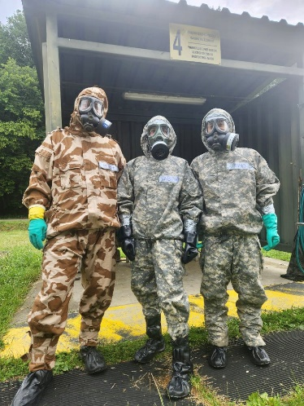
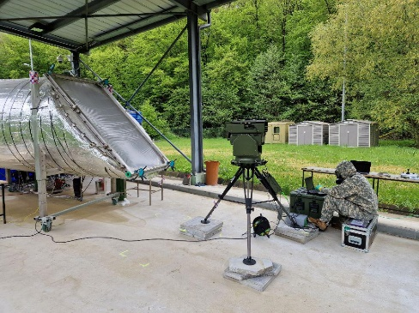
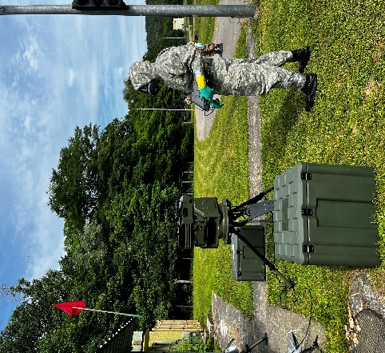
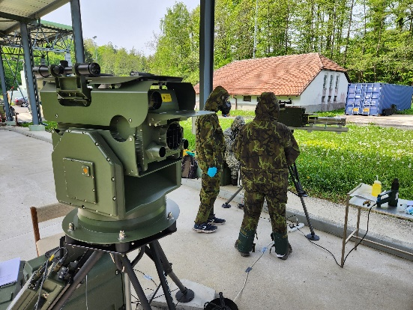
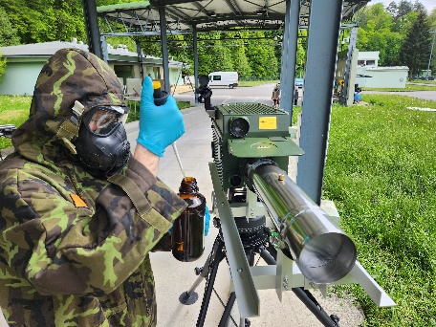
FALCON 4G BETWEEN THE PROVING GROUNDS – testing with live agents (GB, HD)
TRAINING AND TESTING CENTRE OF CBRN PROTECTION- ZEMIANSKE KOSTOLANY, SLOVAKIA
TRAINING AND TESTING CENTRE OF THE MILITARY RESEARCH INSTITUTE, VYSKOV, THE CZECH REPUBLIC

Slide 16
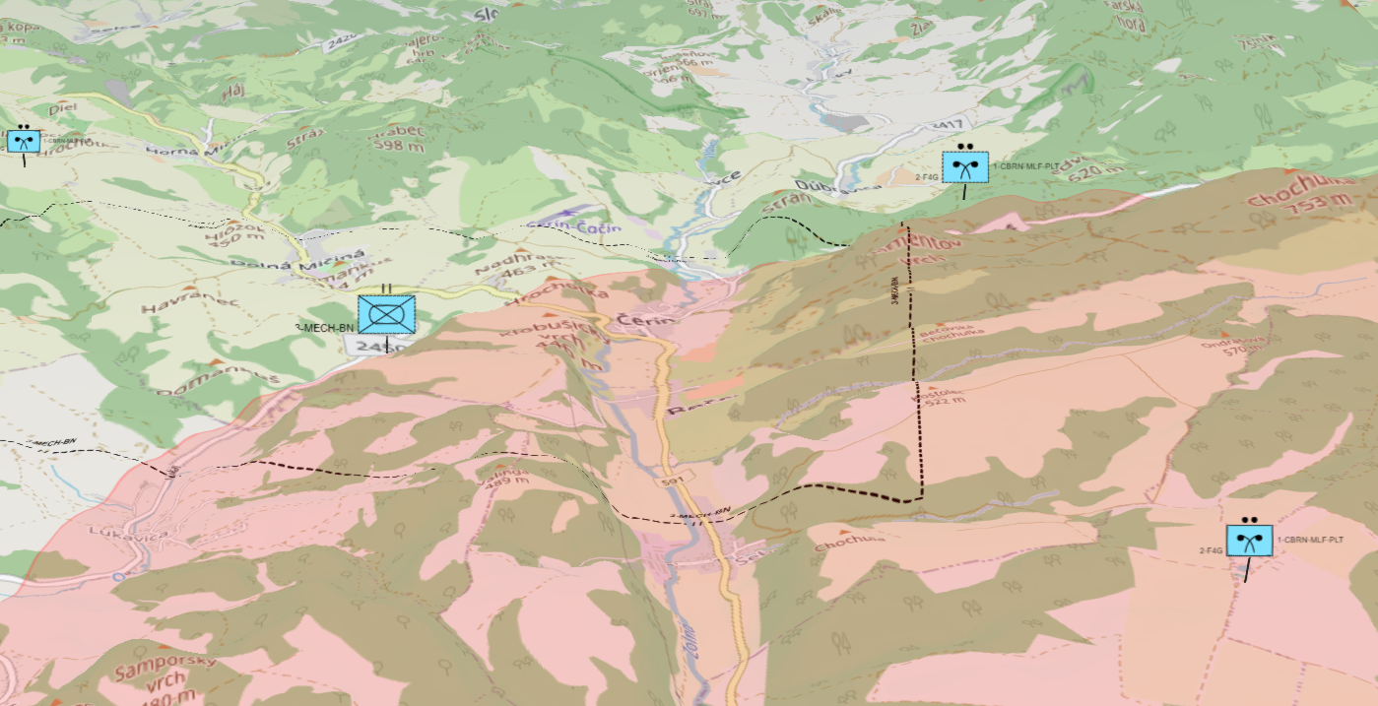
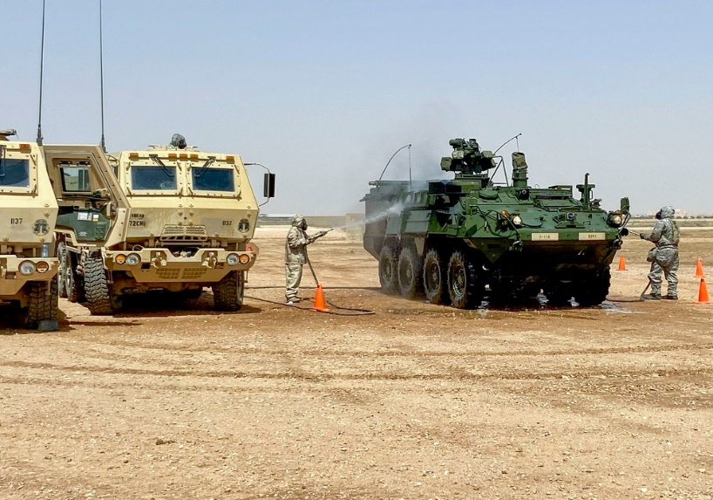
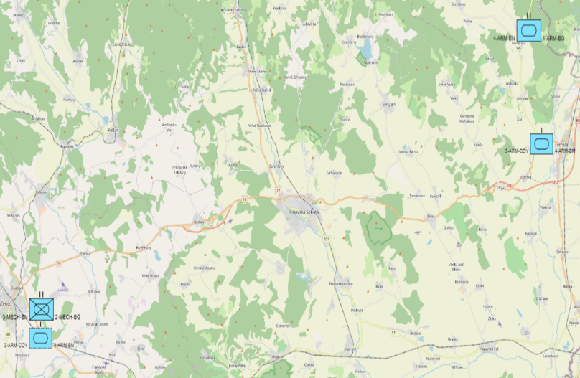

FALCON 4G SUPPORTS RECONNAISSANCE MISSIONS
AREA/ZONE RECONNAISSANCE
Mechanized Battalion
(3x5 km)
Base Protection
OTHER
Fast Results in Reconnaissance and Hazard Avoidance
Minimizing the Risk of Contamination
ROUTE RECONNAISANCE
Gathering of information along a specific route
Confirm or denying the presence of hazards

Slide 17

THANK YOU FOR YOUR ATTENTION
sr@sec-technologies.com
All information provided in the presentation are subject to change without prior notice.

